Slide 1
House Price Prediction
Shunling Guo, PhD

Slide 2
Overview
Problem to solve and Audience
Solution:
Data Cleaning and wrangling
Exploratory data analysis
Statistical analysis
Machine learning modeling
Case Story
Data Insights

Slide 3
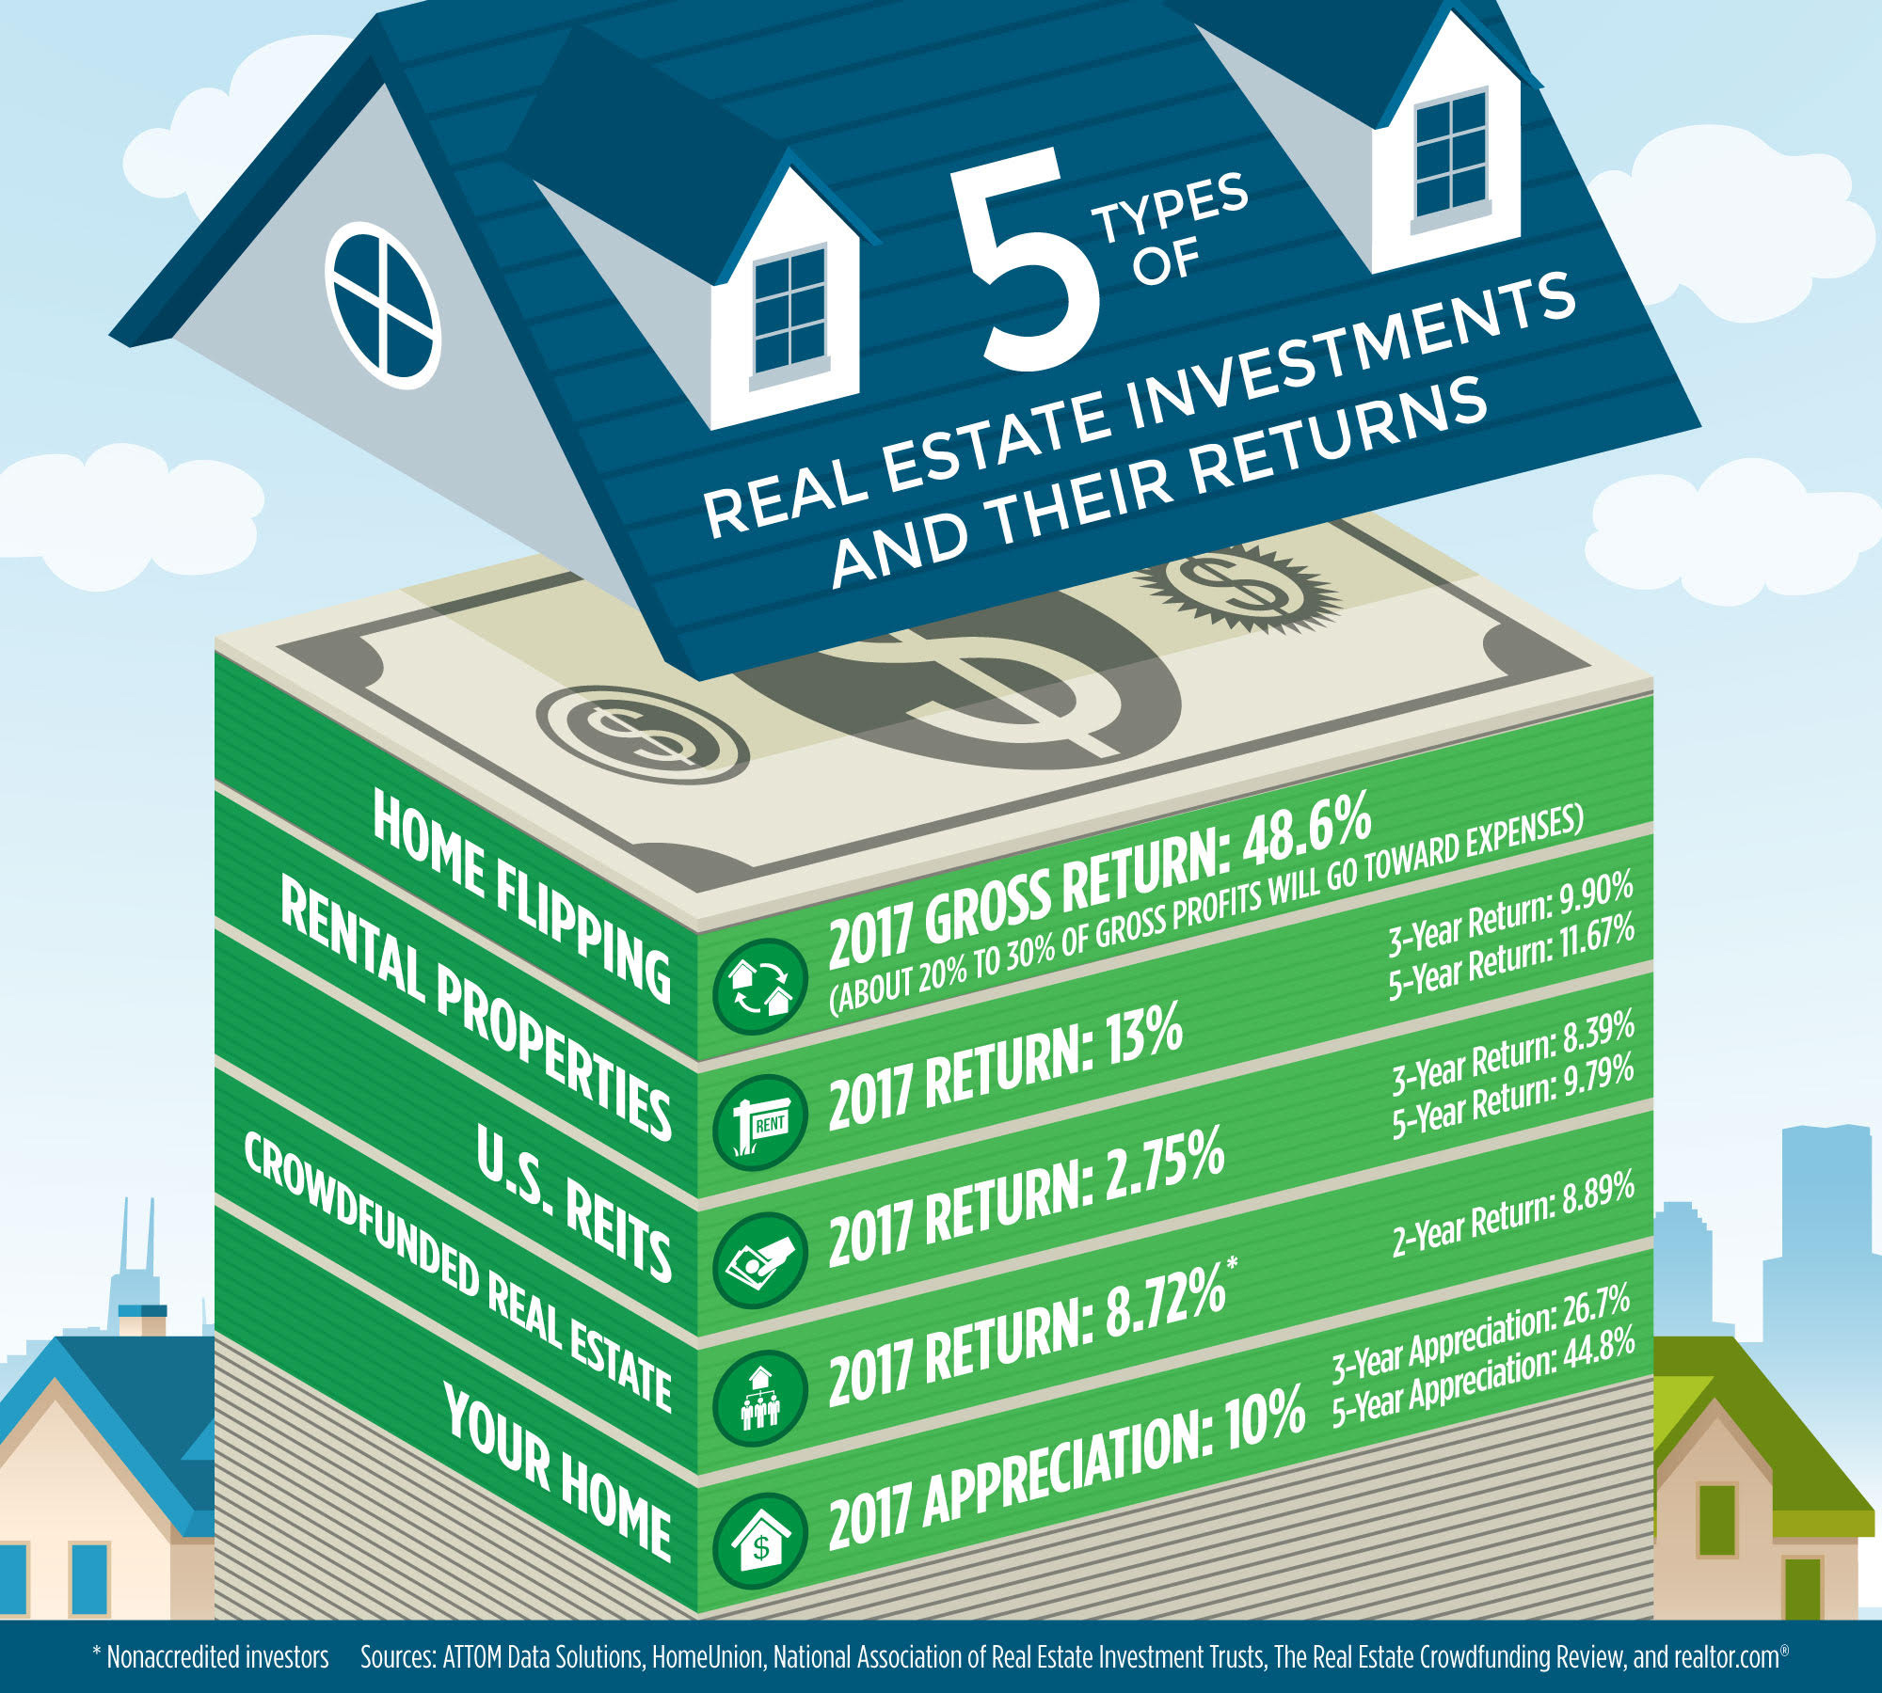

Predict house price is essential for
Real Estate Investment and Development

Slide 4
Solutions
Data Wrangling
EDA
Statistical analysis
Machine
Learning
Feature
Analysis
Data
Insights
•Fill NA
•Parse date
•Change year to age
•preprocess categorical data to dummy table
•normalize data
•Feature distribution
•Feature correlation
•Check Imbalance
•Time series plot
•Infer statistics of house price for specific features or categories
•Test hypothesis
•Polynomial regression with feature selection tuning
•Random forest with parameter tuning
•Xgboost with fine tuning
•Feature importance hierarchy
•Case study of feature importance with causal/correlation validation to mine driven forces.
•recommend feature for marketing
•draw conclusion for investment
•insight for real estate development

Slide 5
Results
Comparison of different regression models:
regression | Best Cross validation r2 score | Best Testing score
Polynomial | 0.84 | 0.76
Random forest | 0.87 | 0.83
Xgboost | >0.99 | 0.87

Slide 6
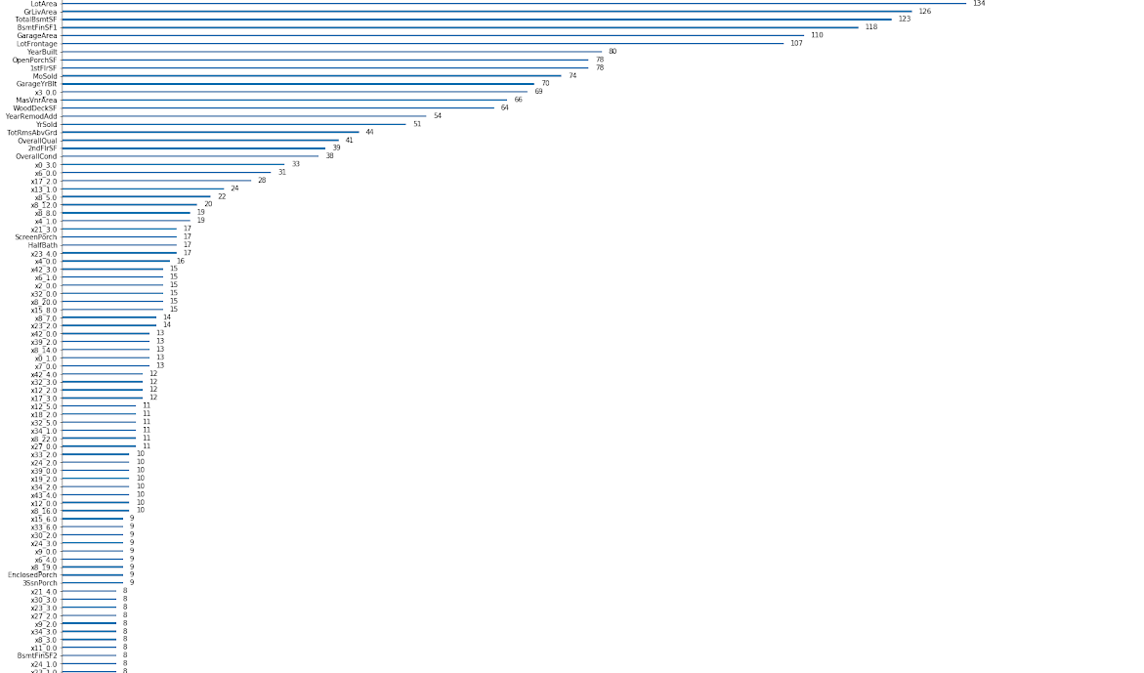
Feature importance hierarchy:
High hierarchy feature key words:
Quality
Age
Size
Neighborhood
Low hierarchy feature key words:
Porch
Fence
Pool
Utility
Outside condition

Slide 7
Case study for mining driven forces:
Choose one feature from important feature category:
Quality: OverallQual
Age: YearBuilt
Size: GrLivArea
Choose one feature from instantly thought important:
Bedroom number: BedroomAbvGr

Slide 8
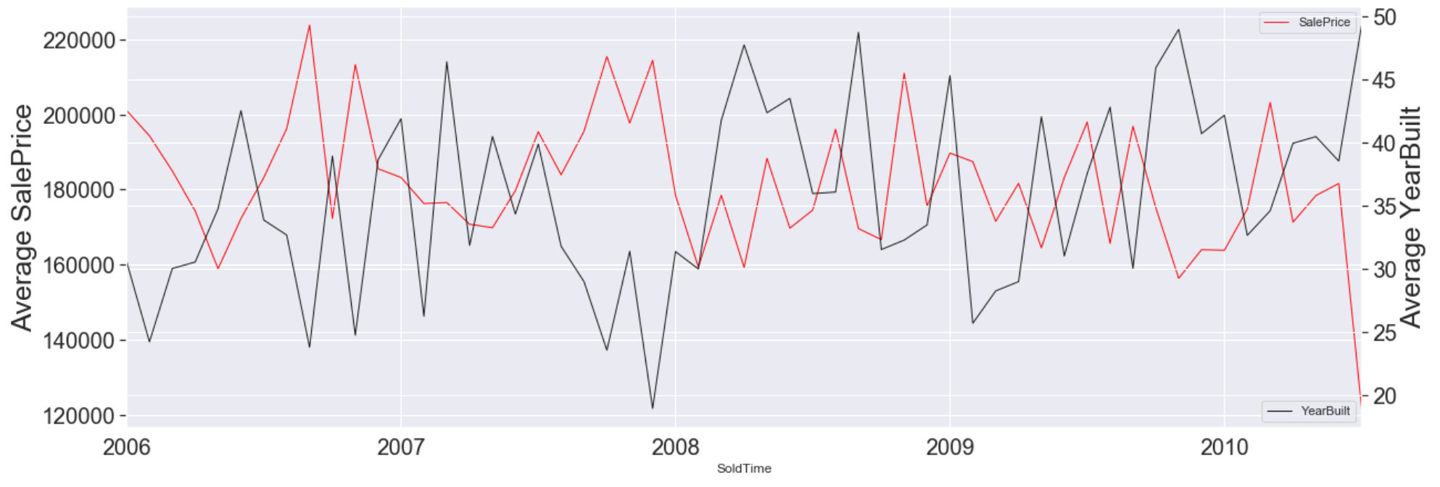
Time series view:
Age of house and Sale Price correlation trends over time.
Y axis is average house sale price (red, SalePrice) or average home age (black, YearBuilt) of sold houses within a month. X axis is Sold Time with precision of a month.
We see a negative correlation along time between the two.

Slide 9
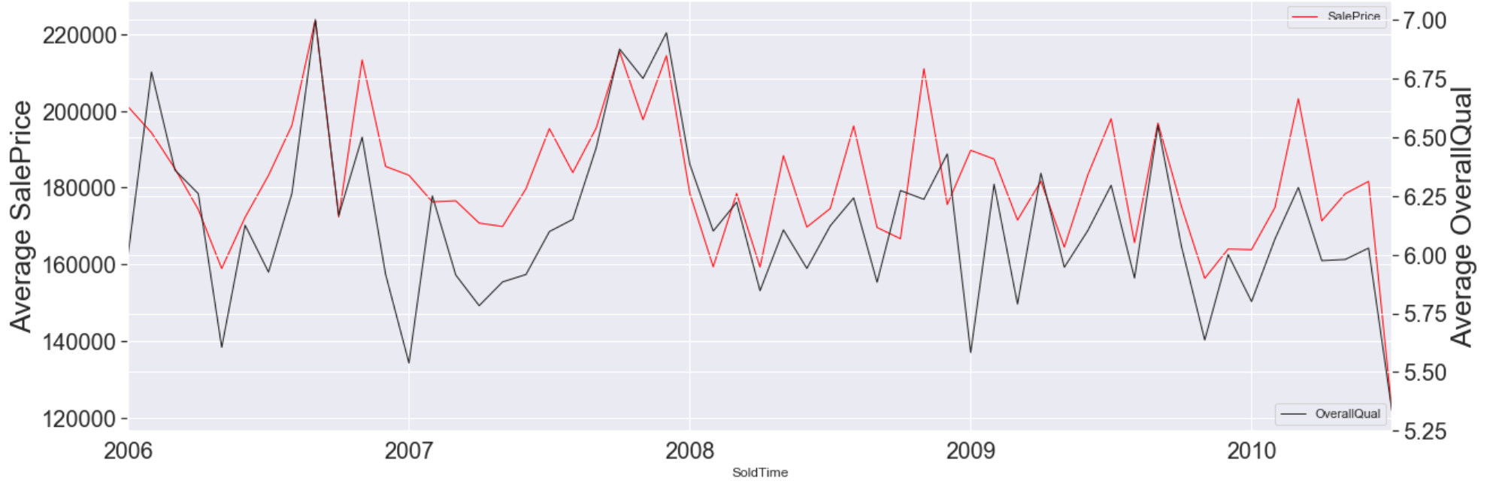
Time series view:
House quality and Sale Price correlation trends over time.
Y axis is average house sale price (red, SalePrice) or average home quality (black, OverallQual) of sold houses within a month. X axis is Sold Time with precision of a month.
We see a negative correlation along time between the two.

Slide 10
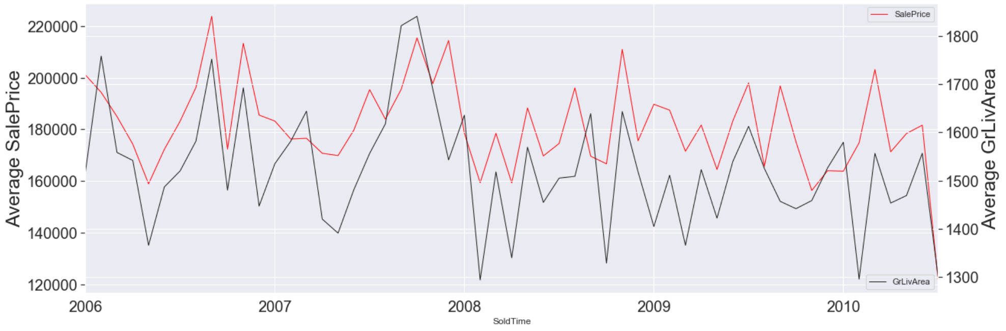
Time series view:
Living area and Sale Price correlation trends over time.
Y axis is average house sale price (red, SalePrice) or average living area (black, GrLivArea) of sold houses within a month. X axis is Sold Time with precision of a month.
The correlation is harder to predict, most times are positively correlated, but sometimes see negative effect.

Slide 11
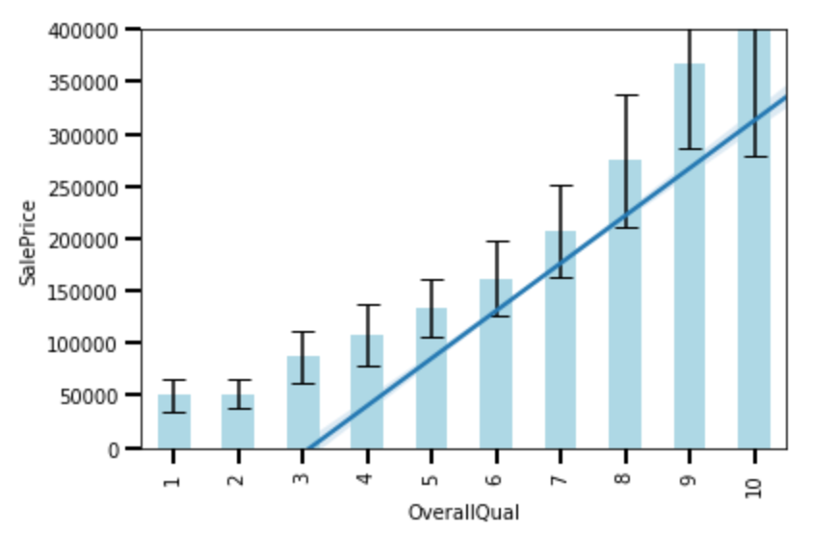
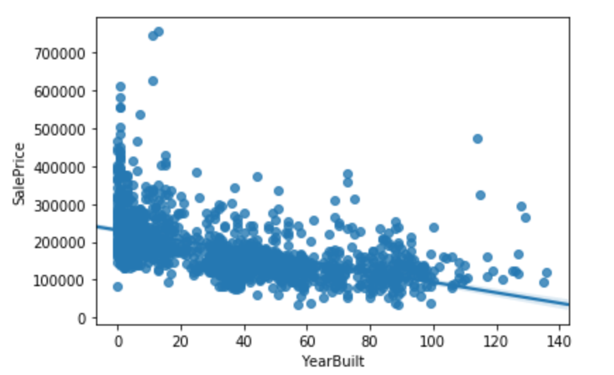
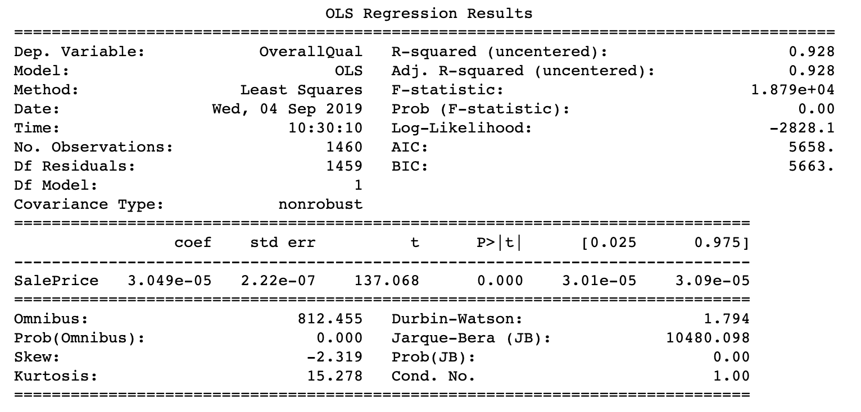
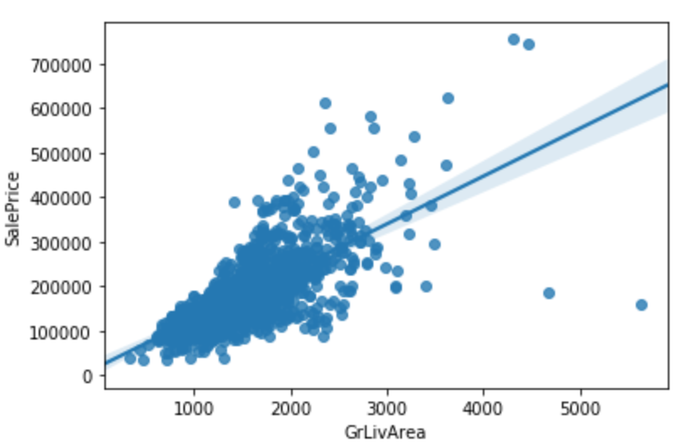
Statistical inference:

Slide 12
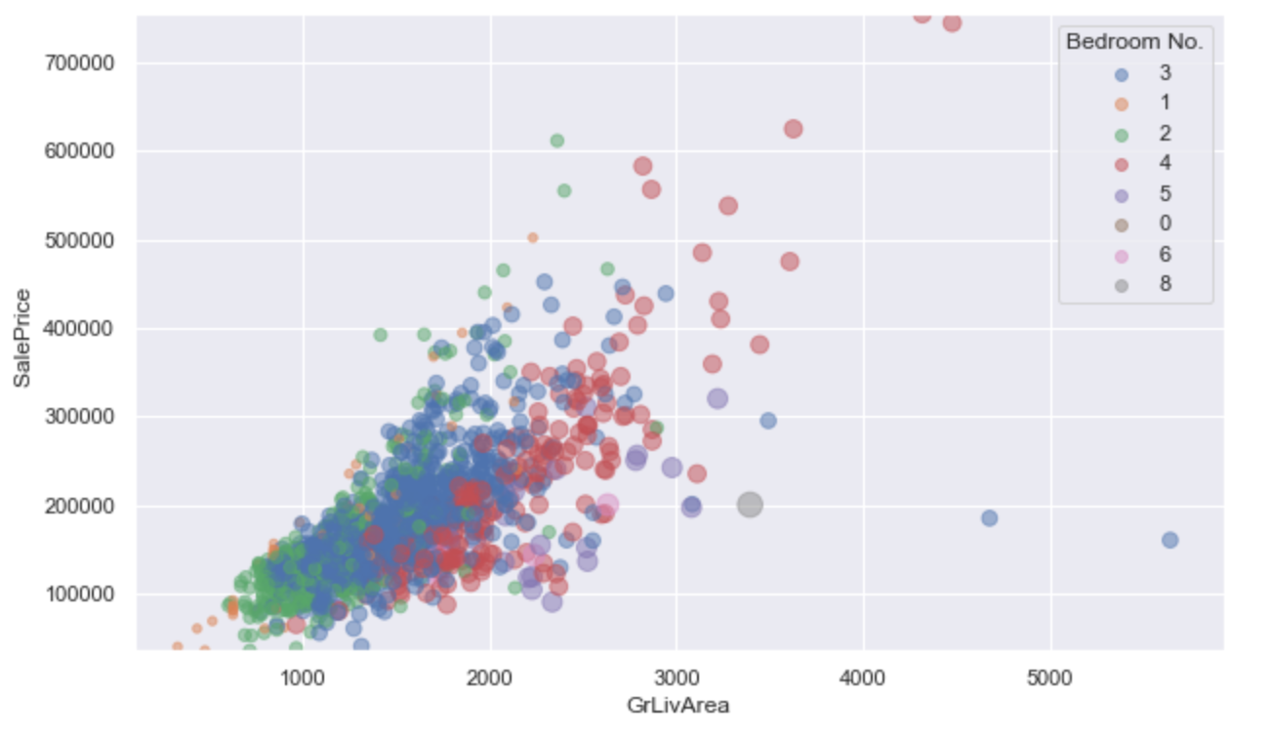
Bedroom number influence:

Slide 13
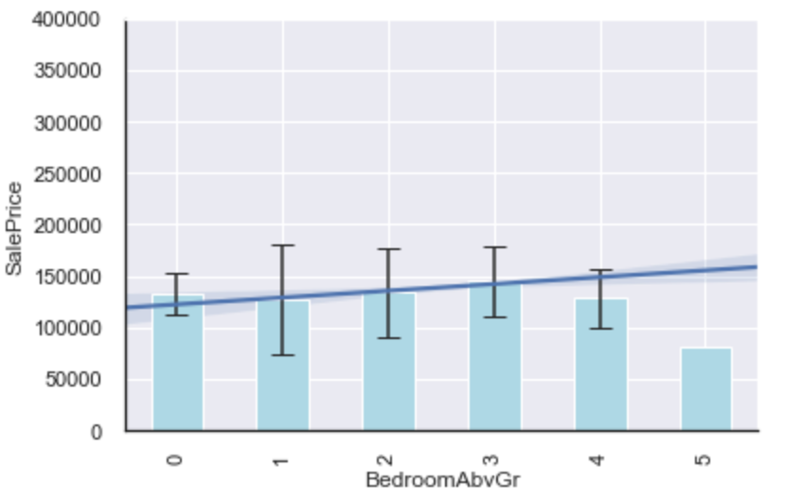
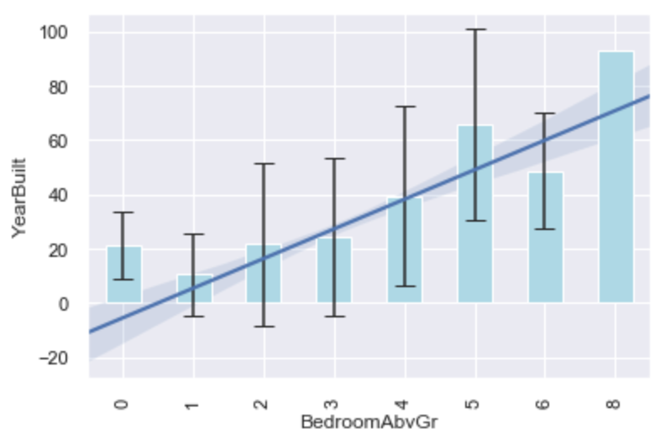
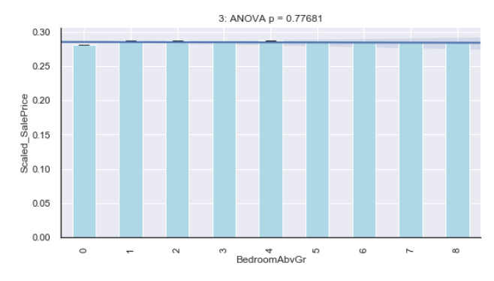
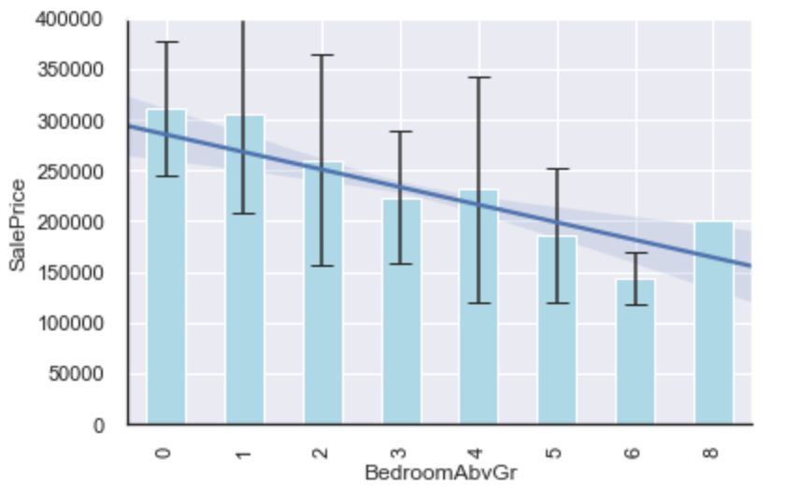
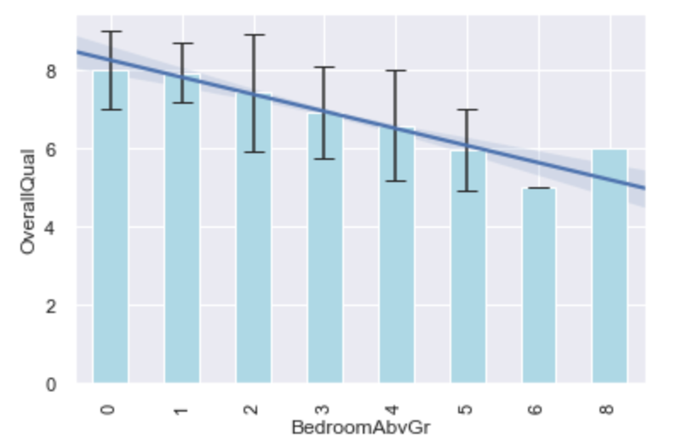
Bedroom number negatively correlated with house price in big houses (>1500 sqft).
Bedroom number correlated with house age and quality.
Bedroom number is not a driven force to affect house price according to model based simulation.

Slide 14
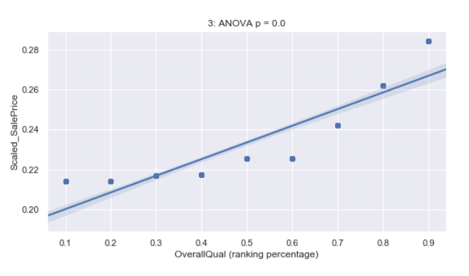
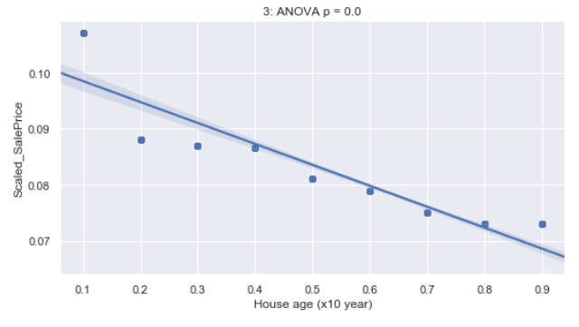
House age and quality are two driven forces:

Slide 15
Business insights:
Marketing:
In this area, bedroom number is not a popular feature, therefore no need to highlight.
Top 10 important features:
Area of: Basement, living, garage, lot, porch and miscellaneous
Age of house and remodel
Month sold, wood deck
Investment:
Price during time is quite stable, no appreciation value, but with low risk.
Real Estate Development:
Using model to predict house and estimate revenue.

